Slide 1
CSS Grid
Front-End Web Development

Slide 2
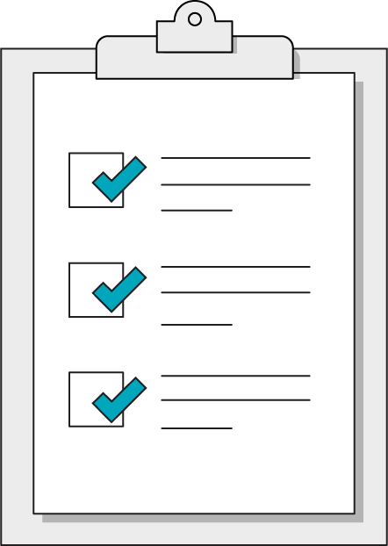
Today’s Learning Objectives
In this lesson, you will:
Create responsive layouts using CSS Grid properties.
Compare and contrast flexbox and Grid properties.
Define fractional and percentage-based widths for elements.
‹#› | © 2020 General Assembly

Slide 3
Warm-Up: The Bad Intern
Front-End Web Development

Slide 4
The Bad Intern
Your client has had an intern work on a content page and something has gone horribly wrong. They are now in a panic and have asked you to try to repair the damaged page.
Starter code:
https://drive.google.com/drive/folders/1iu8NuEt_y9v2z3Ap_SABqPOErz5iuY6A?usp=sharing
Solution code:
https://drive.google.com/drive/folders/1iu8NuEt_y9v2z3Ap_SABqPOErz5iuY6A?usp=sharing

Slide 5
Flexbox Questions
Think!
In which direction does a flexbox natively go: horizontal or vertical?
What CSS property adjusts that?
How do you reorder flexbox children?
What CSS property adjusts that?
Can you nest a flexbox inside of a flexbox?
Why would we want to do that? Doesn’t flexbox fix everything?

Slide 6
CSS Grid
Front-End Web Development

Slide 7
What Is a Grid?
Picture spreadsheets: Columns and rows into which you can lay content.
Grids ensure that elements will line up smoothly across the page.

Slide 8
Comparing Three Tools for Layouts
Floats
Flexbox
Grid
Floats help flow text around an image; they aren’t great for layouts.
Interrupt regular document flow.
Flexbox only works in ONE dimension at a time, with a main axis and a cross axis.
However, you can nest flex containers.
Grid works in two dimensions all of the time, defining rows and columns.
A clearer declaration of complicated patterns.

Slide 9
Flexbox Can Be a Row (flex-direction: row;)
1
2
3
4
5

Slide 10
Or a Column... (flex-direction: column;)
1
2
3

Slide 11
But flexbox can’t be both!
‹#› | © 2020 General Assembly

Slide 12
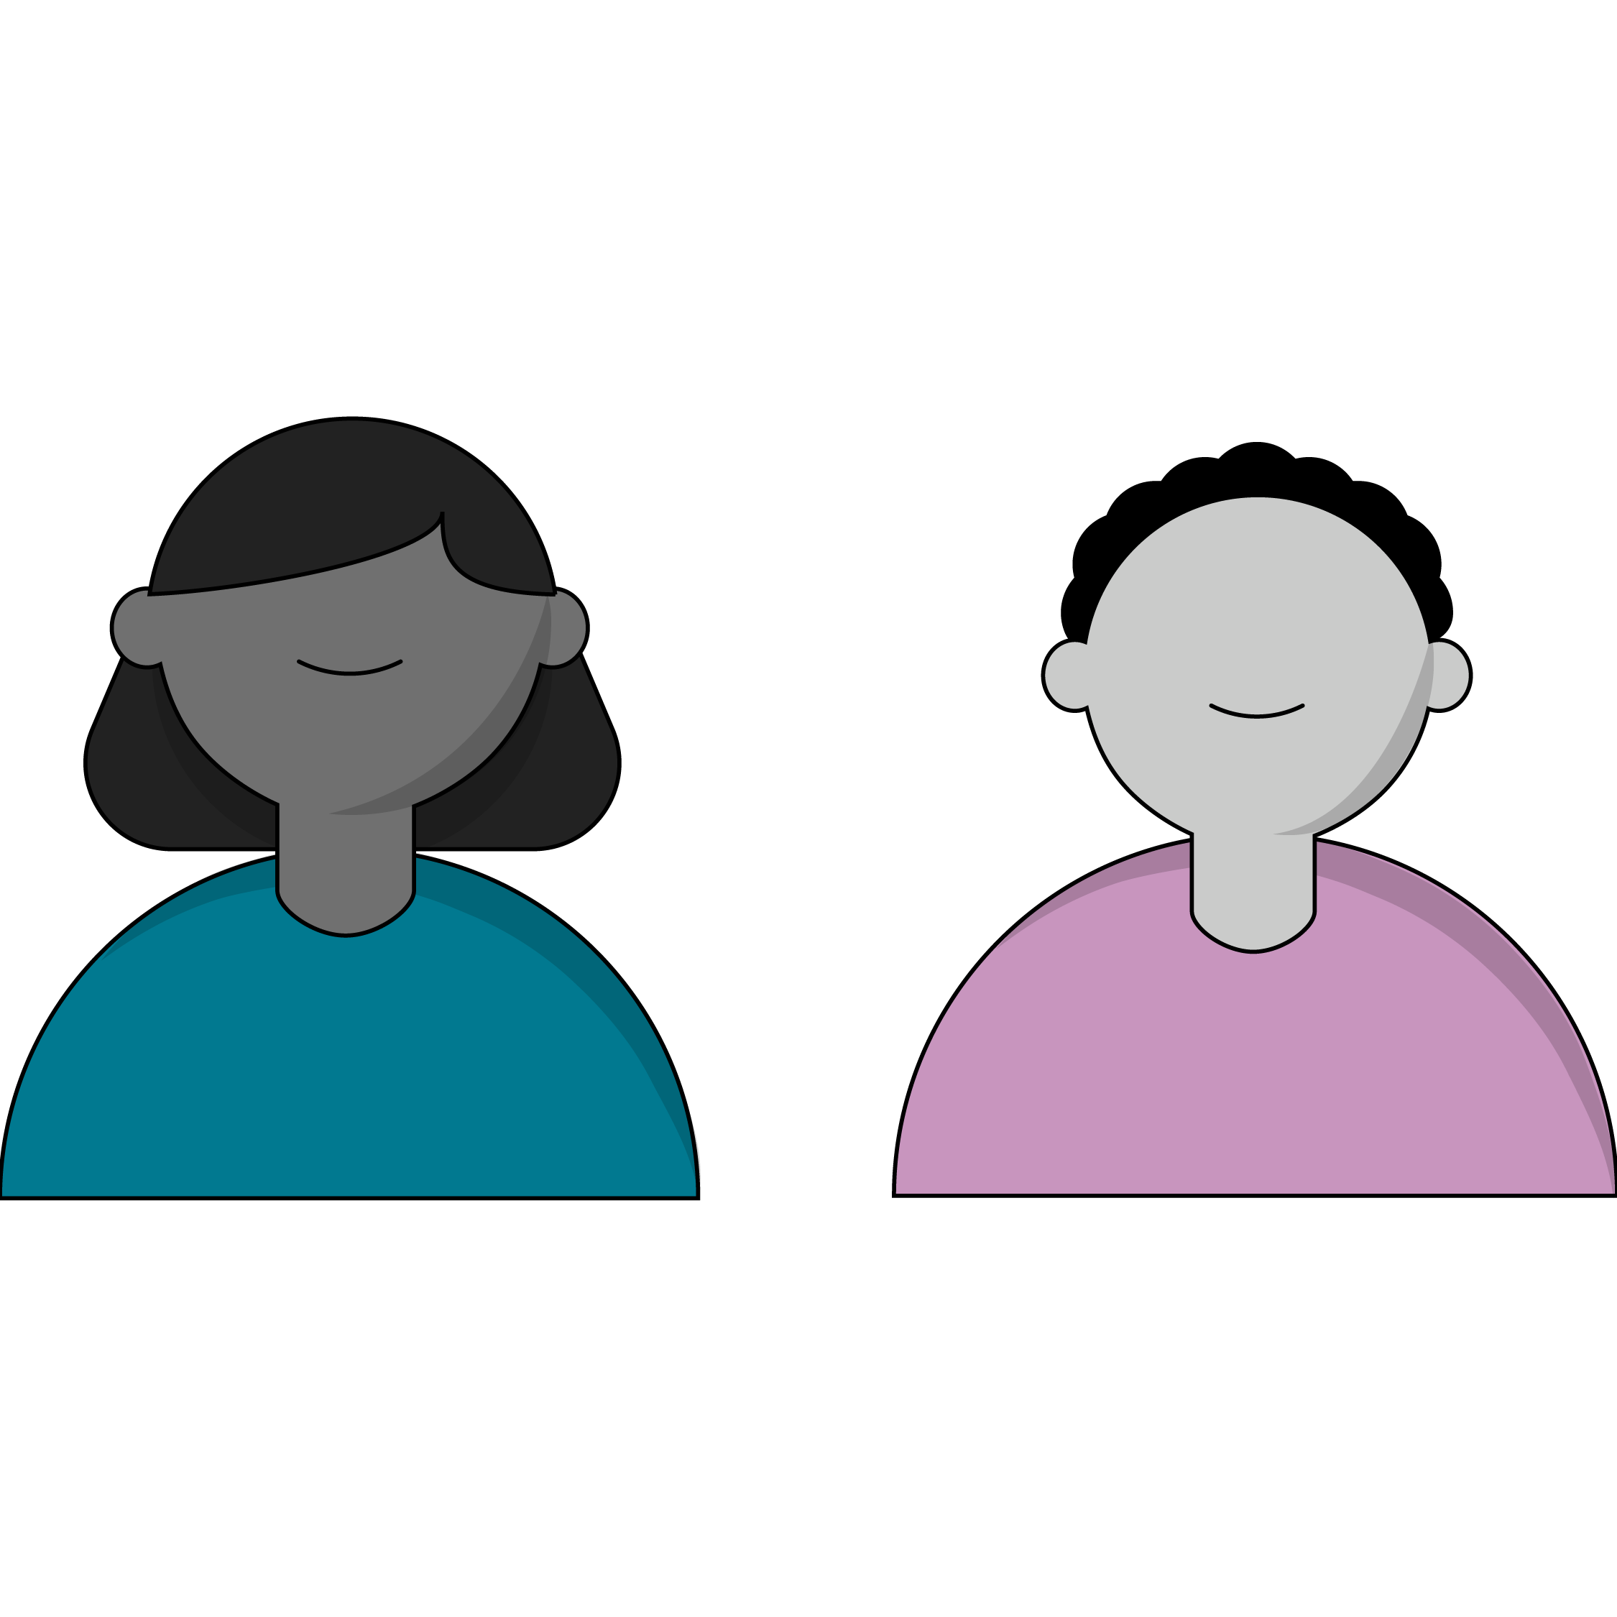
CSS Grid: A Cousin of Flexbox
Built with the modern web in mind.
Natively responsive.
Parent container → child Grid item relationship.
Much like flexbox, a parent (or “container”) element will define the layout for its children.

Slide 13
Using CSS Grid
Front-End Web Development

Slide 14
Grid Tracks
(That’s what the rows and columns are called.)

Slide 15
Grid Tracks
(That’s what the rows and columns are called.)

Slide 16
Use display:grid on the Container Element
.container {
display: grid;
}
Unlike display:flex, Grid doesn’t give us much by default. We’ll have to define the template for our grid according to the rows and columns we want.

Slide 17

Think! What Kind of Layout Do You Want?
2 rows, 3 columns?
20 rows, 1 column?
9001 rows, 42 columns?

Slide 18
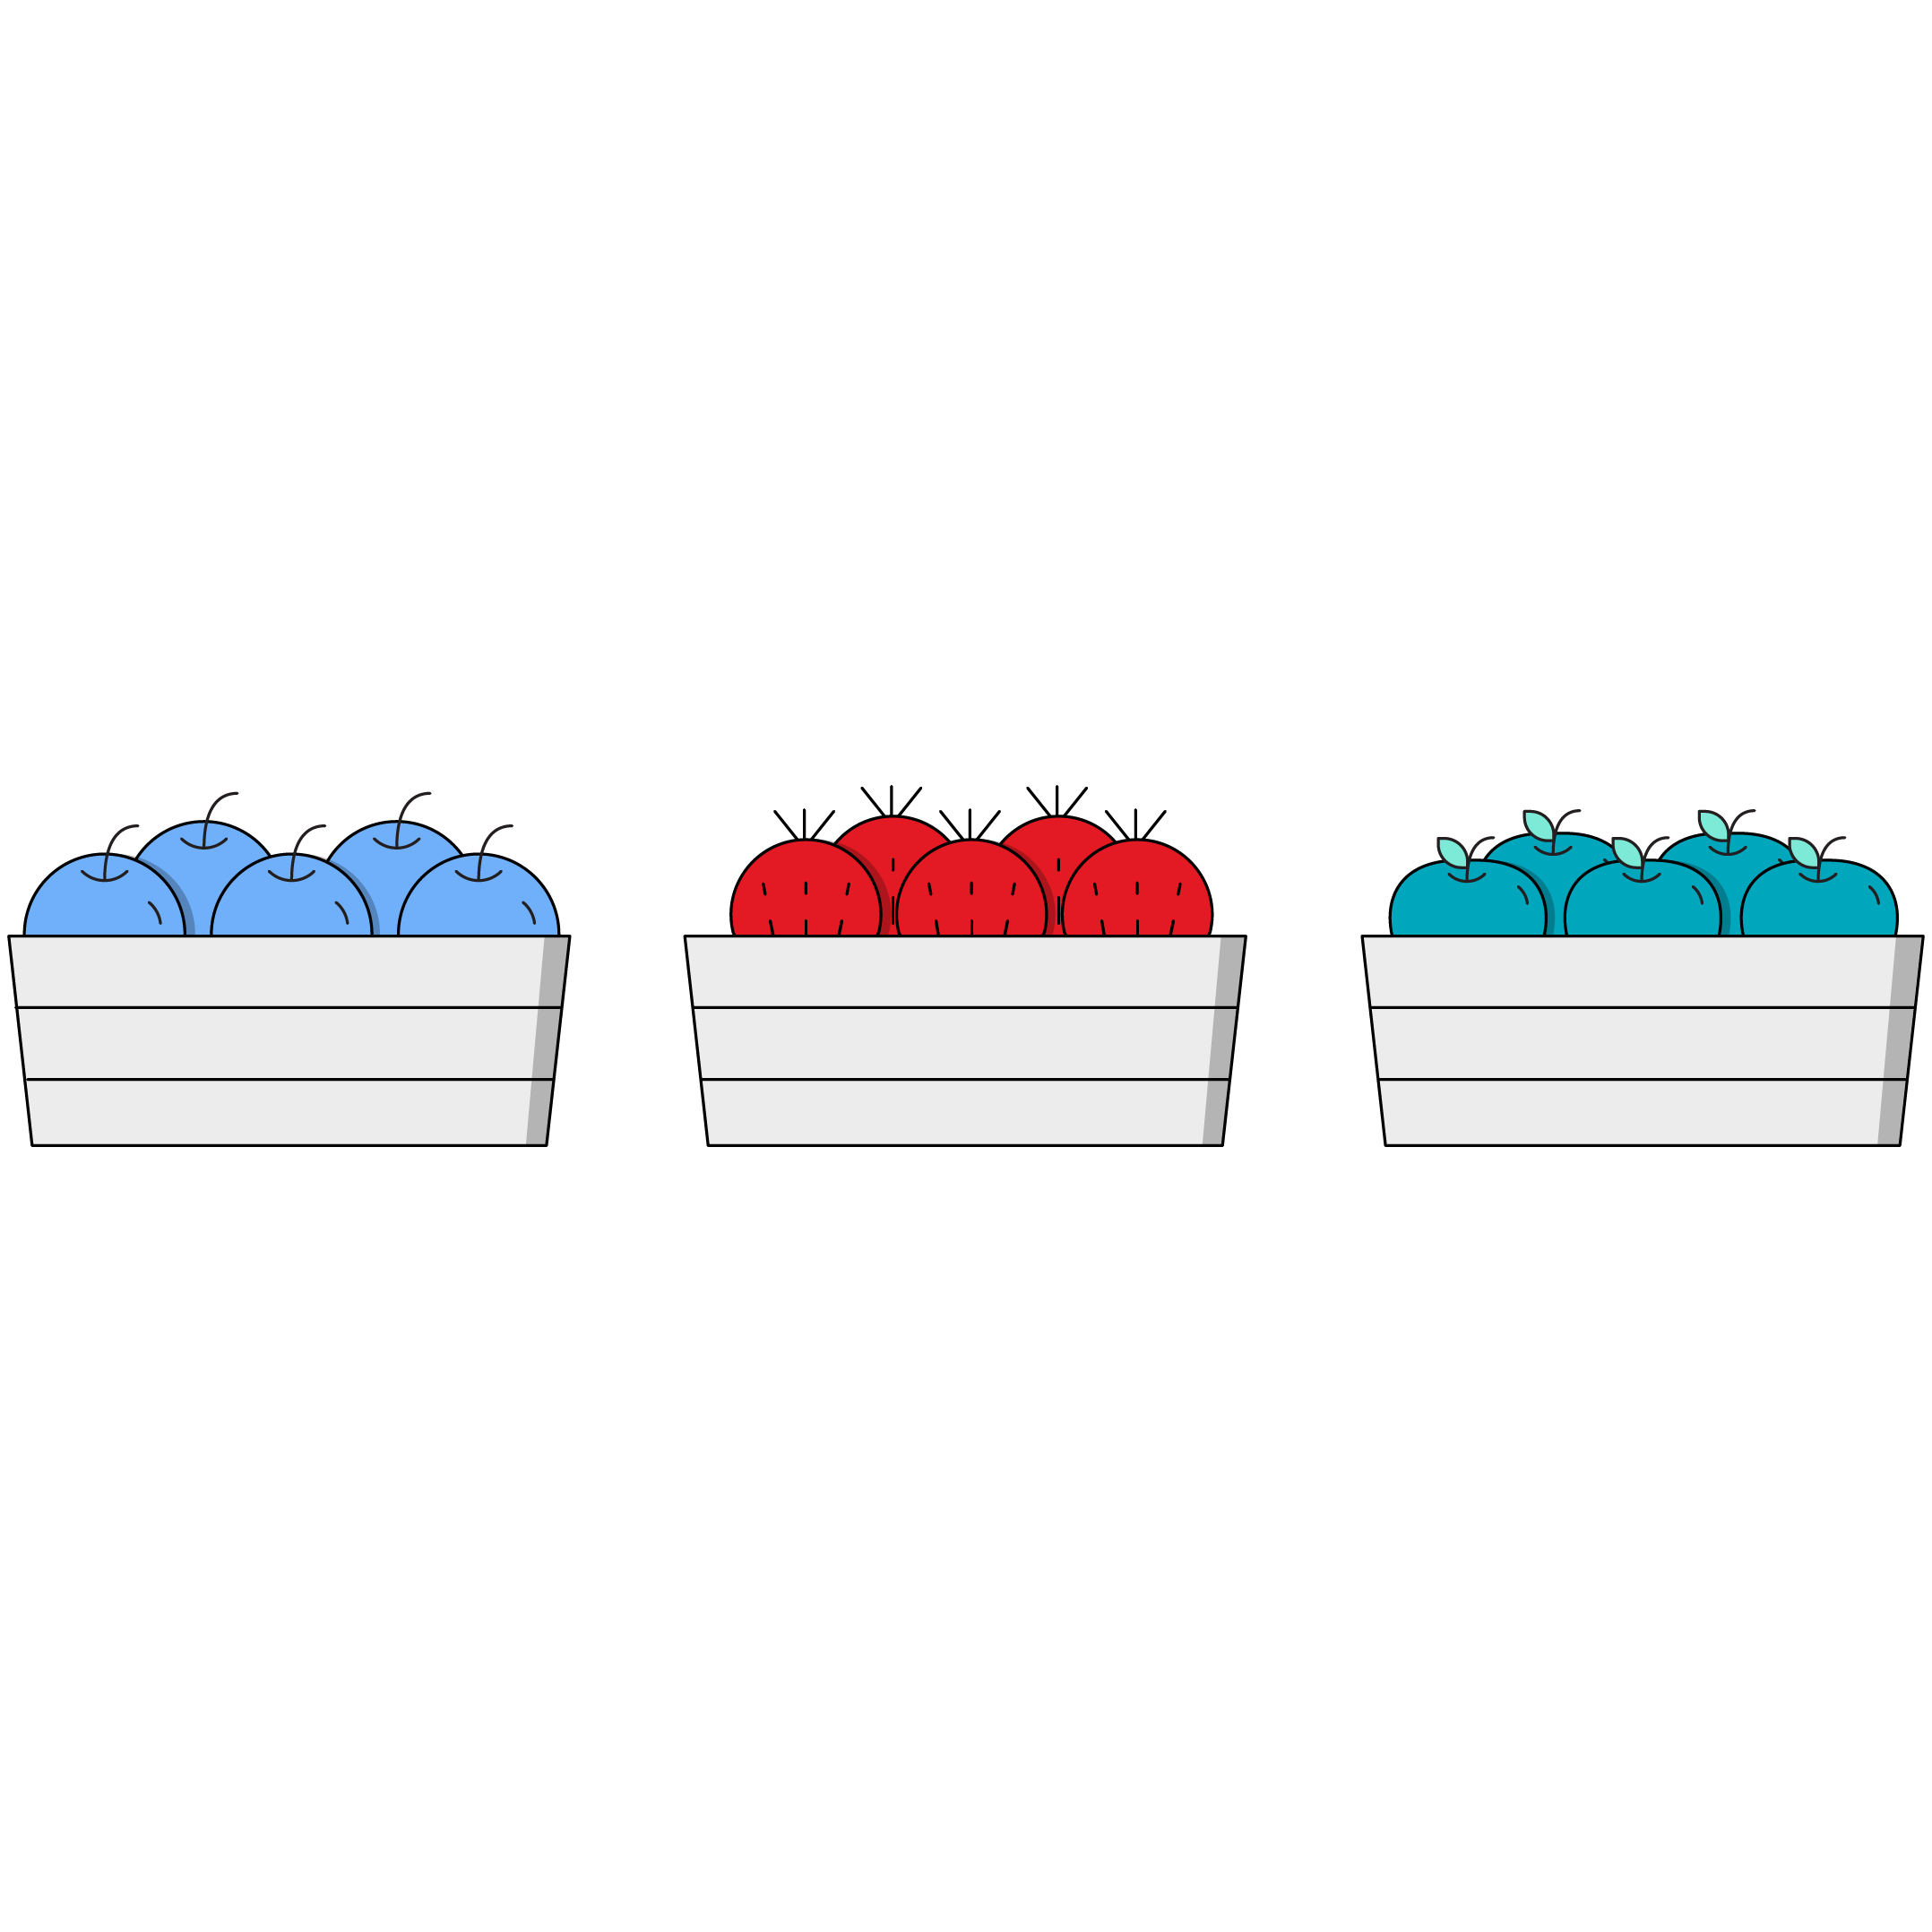
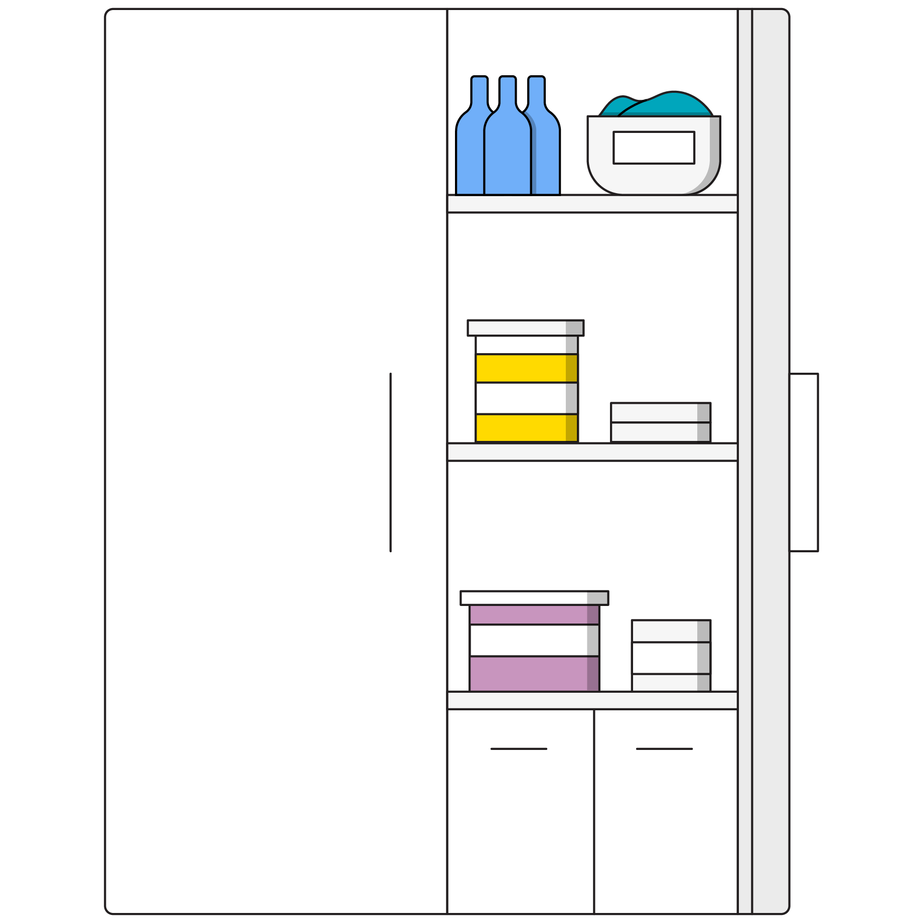
Define Your Rows and Columns
Rows
Columns
Use the CSS property
grid-template-rows.
Use the CSS property
grid-template-columns.

Slide 19
Basics in <html>
Let’s create a set of <div>’s inside of <section> tags.
<section class="container">
<div class="item">1</div>
<div class="item">2</div>
<div class="item">3</div>
<div class="item">4</div>
</section>

Slide 20
Basics in CSS
You’ll need to use grid-template-columns and grid-template-rows on the parent to create a simple grid.
/* 2 column, 1 row grid */
.container {
display: grid;
grid-template-columns: 100px 100px;
grid-template-rows: 100px;
}

Slide 21
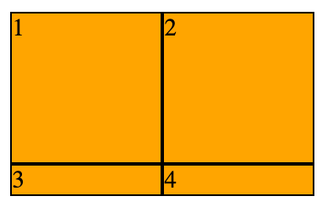
All Together Now!
/* 2 column, 1 row grid */
.container {
display: grid;
grid-template-columns: 100px 100px;
grid-template-rows: 100px;
}
.item {
background-color: orange;
}

Slide 22
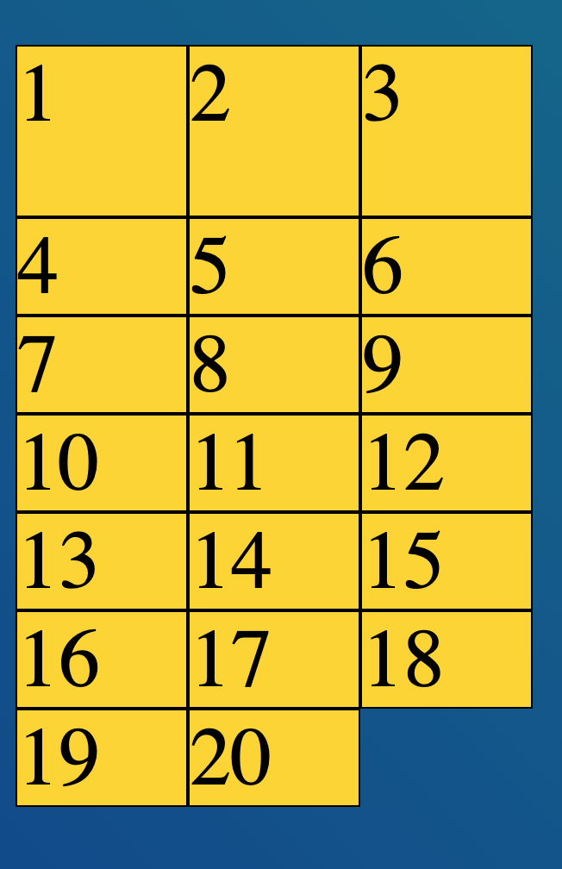
A Basic Grid Example
Check out the grid in this example as a reference for using CSS Grid properties.
Reference code:
https://drive.google.com/drive/folders/1MV5eLNCLhhXlCPYf02AJGkpxiOBJAF5N?usp=sharing

Slide 23
Implicit Tracks
Front-End Web Development

Slide 24
Implicit Tracks
You can leave off grid-template-rows and CSS Grid will automatically make the rows (conceptually, this is called the “implicit grid”).
If we don’t know how many rows our content will take, can we still define their height?
Turns out there’s a property called grid-auto-rows for just that purpose!

Slide 25
This Also Works
/* 2 column, ?? row grid */
.container {
display: grid;
grid-template-columns: 100px 100px;
}
.item {
background-color: orange;
}

Slide 26
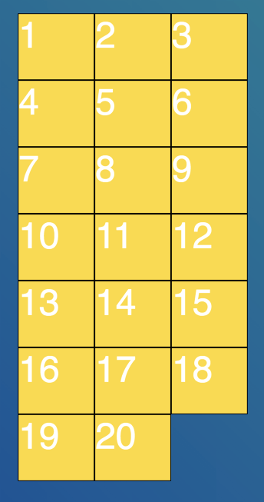
An Implicit Tracks Example
Check out the grid in this example, which uses implicit tracks for its rows.
Reference code:
https://codepen.io/GAmarketing/pen/RwwoPgR

Slide 27
When You Just Need Some Space: gap
Front-End Web Development

Slide 28
Gap (grid-gap)
gap is the margin/padding of CSS Grid. If you want space between your grid items, you apply gap to the container. So easy!
.container {
display: grid;
grid-template-columns: 100px 100px;
gap: 20px;
}
.item {
background-color: orange;
}

Slide 29
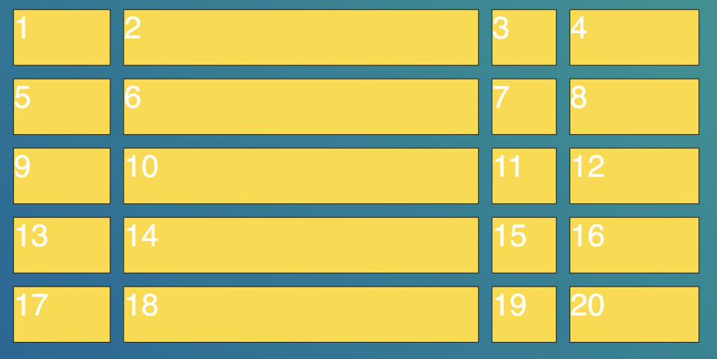
gap (Cont.)
When gap is given one value, it applies an equal amount of space between rows and columns.

Slide 30
Two-Value gap
.grid01 {
display: grid;
grid-template-columns: 100px 100px;
gap: 25px 10px;
}

Slide 31
gap (Cont.)
Keep in mind: gap can take two values, which set column and row padding (respectively).
.container {
display: grid;
grid-template-columns: 100px 100px;
gap: 20px 80px;
}
.item {
background-color: orange;
}

Slide 32
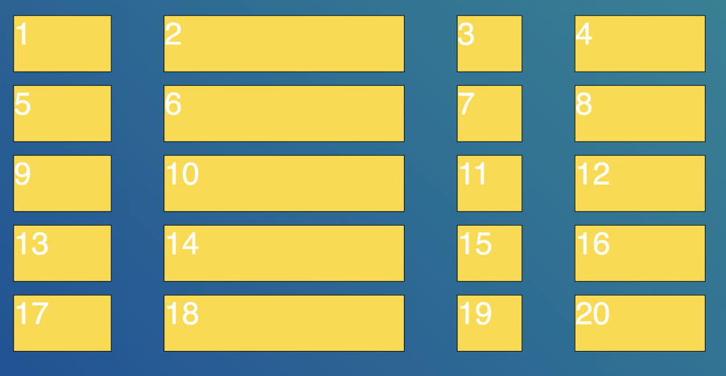
gap (Cont.)
Note the difference when gap is given two values: Different amounts of space between rows and between columns.

Slide 33
A gap Example
Use this code as a reference for incorporating grid-gap properties.
Reference code:
https://drive.google.com/drive/folders/17FxK3LTFr24c2HIwe8xDHWxRRATVv5Jk?usp=sharing

Slide 34
Fractional Units With CSS Grid
Front-End Web Development

Slide 35
Fractional Units
The fractional unit (fr) is a newer unit to be used with CSS Grid (similar to percentages). It stands for fractions of a grid container, and it intelligently takes gap into account.
.container {
display: grid;
grid-template-columns: 1fr 1fr 1fr 1fr;
gap: 20px;
}

Slide 36

Can I Use Different Measurement Values Together?
We can feel free to mix fixed-width and variable-width units such as pixels, fr, and percentages.
They can be used together. When used together with fixed-width units, fr is saying: ‘Use the remainder of the space left over after the fixed-width units.’

Slide 37
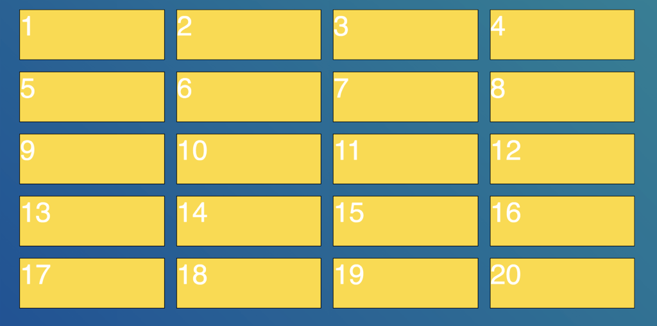
A fr Unit Example
The following code demonstrates how to use fractional units to generate this grid.
Reference code:
https://drive.google.com/drive/folders/1z0mMVm6FZjw5GcDDwnLWuzL9PW9pPMDn?usp=sharing

Slide 38
Layout Challenge
20-30 minutes
Let’s rebuild our layout challenges using CSS Grid.
Starter code:
https://drive.google.com/drive/folders/1Of4DhVVXy09EJVScp6_DDQy-ByuCwuQ3?usp=sharing
Solution code:
https://drive.google.com/drive/folders/1vs3LrTOmOwH5Wix8ZXcRkJstCrD5UR_S?usp=sharing

Slide 39
Mixing Layout Methods
Front-End Web Development

Slide 40
Combining Layout Tools
You can use CSS Grid with flexbox and even floats. They all have a role to play and a purpose in your toolkit.
Float an image when you want text to wrap around it.
Flexbox works great for website navigation and big horizontal sections.
Grid is a great tool for large, repetitive display patterns.
Experiment! There isn’t just a single way to build layouts; experience will help you select the right tool.

Slide 41
Key Takeaways
For Next Time
Grids Use Two Dimensions
HTML + CSS Layouts Lab
Define rows and columns in either pixels or responsive units.
Implicit tracks can be used to expand patterns indefinitely.
We’ve learned a lot so far. Time to put it to good use!

Slide 42
Git
Front-End Web Development

Slide 43
What Is Git?
Git is a database for all of your code (version control).
It's a particular kind of version control called distributed version control. This means multiple people can make edits to the same codebase at once.
This can be a hard concept to wrap your head around — see the diagram on the next slide.

Slide 44
Server Computer
Version Database
version 3
version 2
version 1
Computer A
Computer B
file
file
Version Database
Version Database
version 3
version 3
version 2
version 2
version 1
version 1
Image Source: git-scm.com

Slide 45
Git Commands
Command | Explanation
init | Creates a repository in the current directory (folder).
add | Stages the specified files to prepare them for a commit.
commit | Saves the current state of the repository.
push | Sends local repository contents to a remote repository.
clone | Downloads a remote repository onto your local machine.
pull | Syncs one version of a repository with another.

Slide 46
Let’s Set Up Our User
git config --global user.name “Your Name”
git config --global user.email “you@yourmail.com”

Slide 47
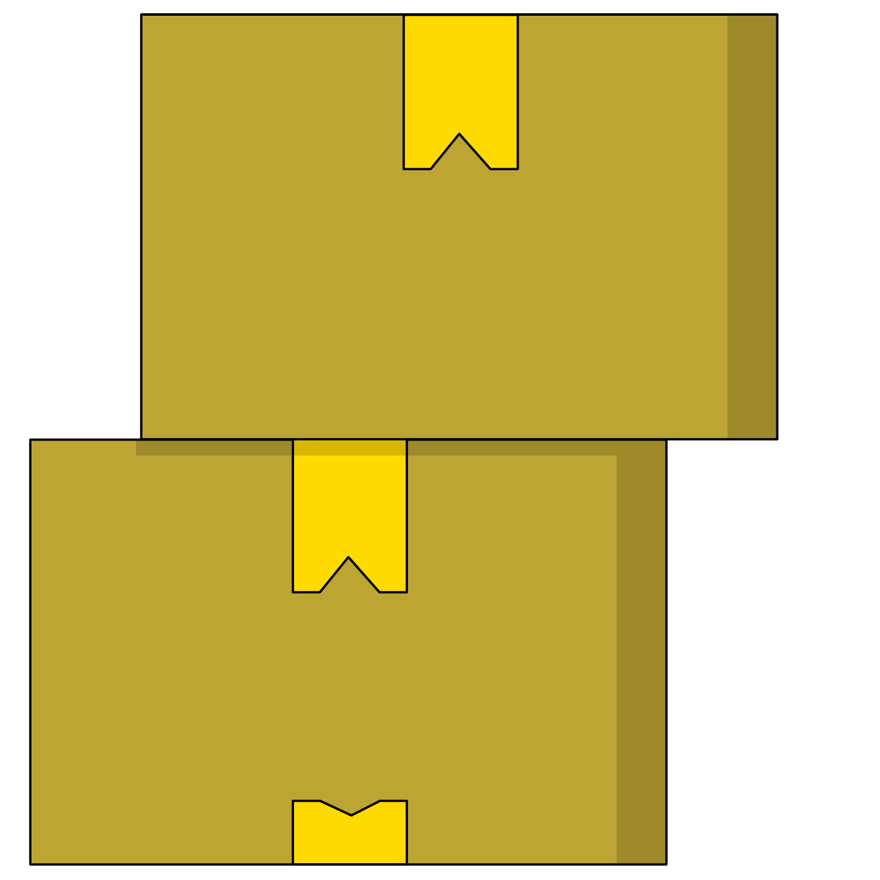
Storing a Project on GitHub
Choose any of the previous assignments or projects and store them in a repository using the command line, then push that repository to a repository on github.com.
Use your text editor to create the folder structure and copy files into a new folder.

